Slide 1

Data Analysis Project
Group Members
Greene
Angel
Caleb
Matt
“E”

Slide 2

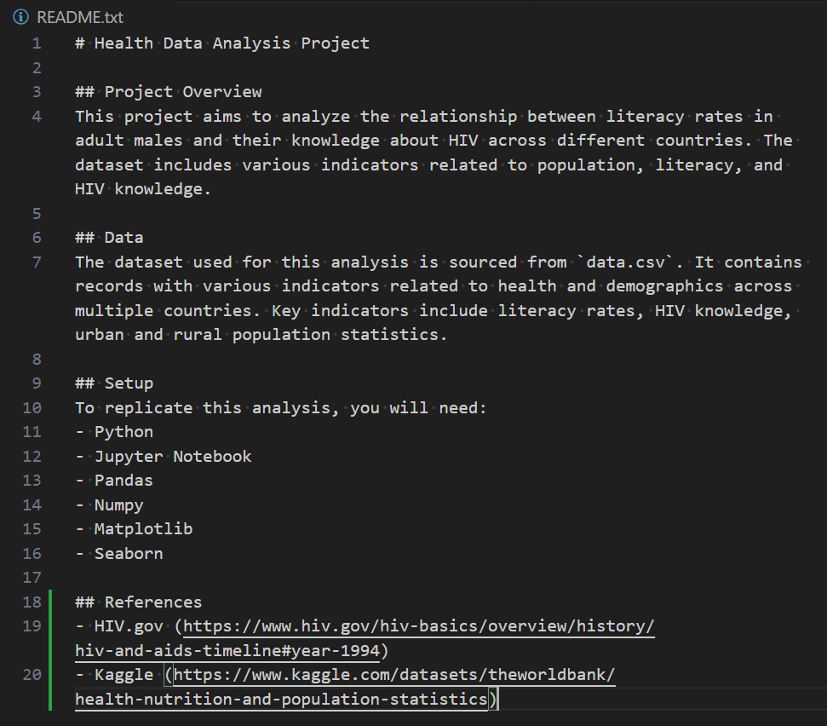
README

Slide 3
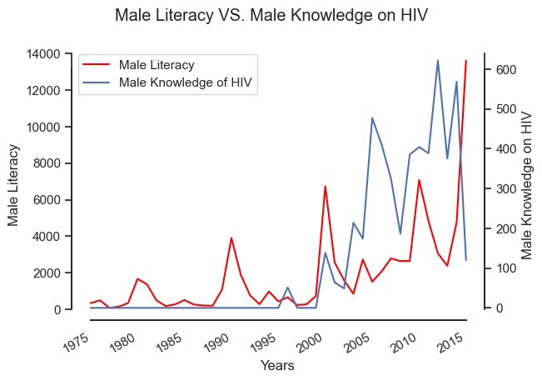
HIV Knowledge & Literacy Over Time

Slide 4
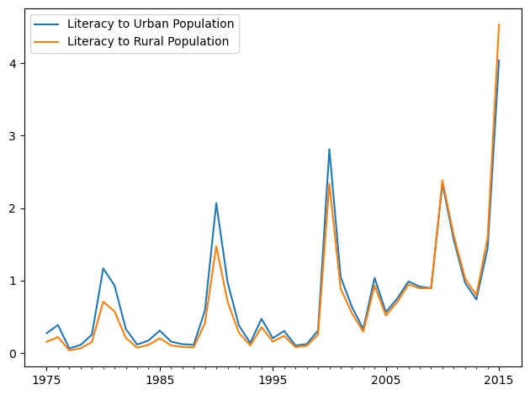
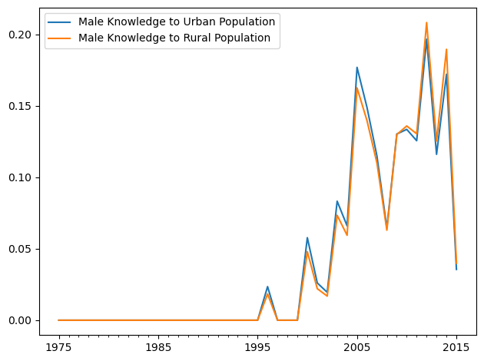
Urban/Rural Population Comparison

Slide 5
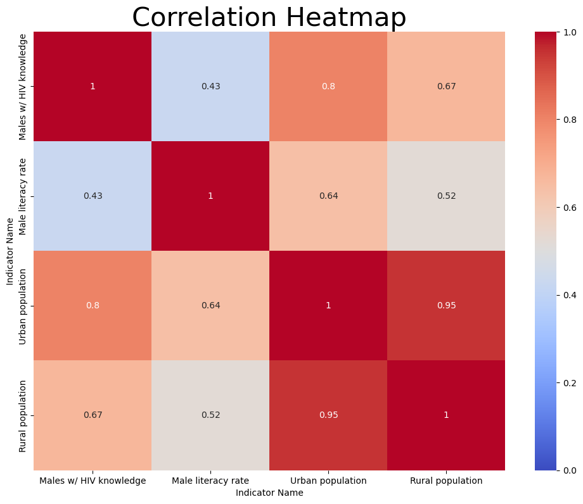
Corollary Data

Slide 6
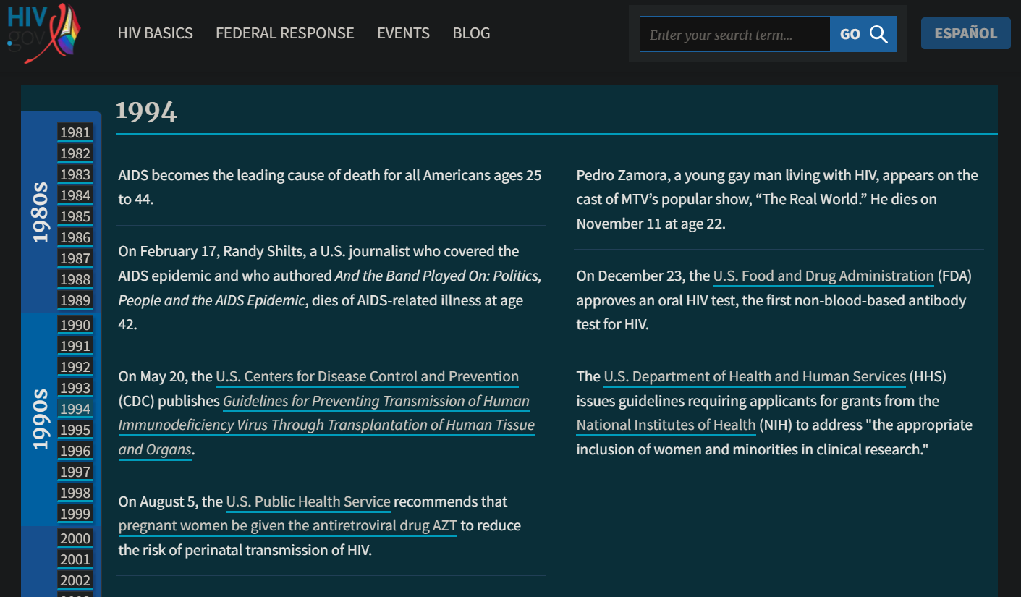
Extrapolations

